Slide 1
Chapter 13 Image-Based Rendering
Guan-Shiuan Kuo (郭冠軒)
0988039217
r07942063@ntu.edu.tw

Slide 2
Outline
13.1 View Interpolation
13.2 Layered Depth Images
13.3 Light Fields and Lumigraphs
13.4 Environment Mattes
13.5 Video-Based Rendering

Slide 3
13.1 View Interpolation
13.1.1 View-Dependent Texture Maps
13.1.2 Application: Photo Tourism

Slide 4
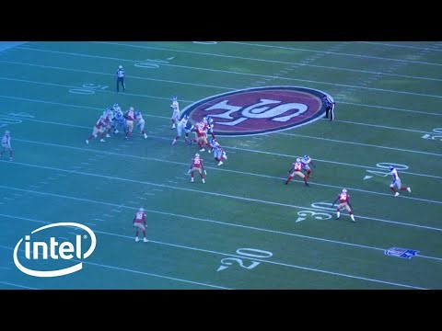
Intel® freeD Technology
https://www.youtube.com/watch?v=J7xIBoPr83A

Slide 5
13.1 View Interpolation
View interpolation creates a seamless transition between a pair of reference images using one or more pre-computed depth maps.
Closely related to this idea are view-dependent texture maps, which blend multiple texture maps on a 3D model’s surface.

Slide 6
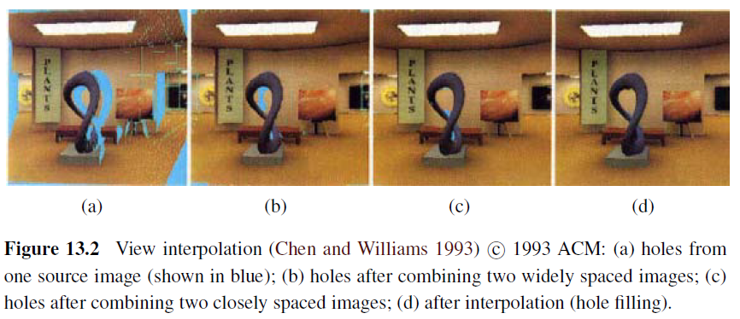
13.1 View Interpolation

Slide 7
13.1.1 View-Dependent Texture Maps
View-dependent texture maps are closely related to view interpolation.
Instead of associating a separate depth map with each input image, a single 3D model is created for the scene, but different images are used as texture map sources depending on the virtual camera’s current position.

Slide 8
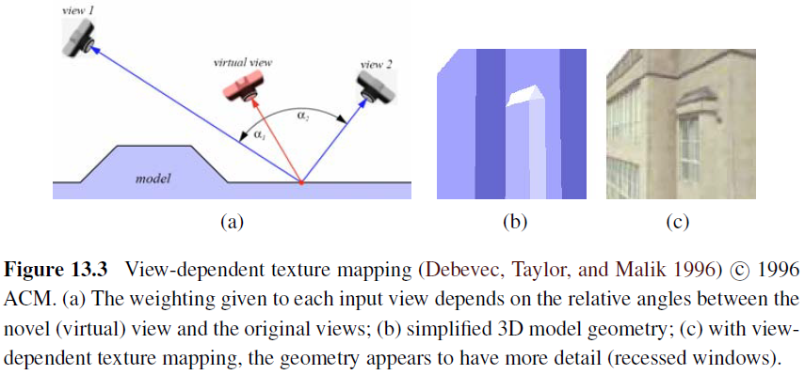
13.1.1 View-Dependent Texture Maps
給的權重跟角度成反比 inversely proportion

Slide 9
13.1.1 View-Dependent Texture Maps
Given a new virtual camera position, the similarity of this camera’s view of each polygon (or pixel) is compared with that of potential source images.
Even though the geometric model can be fairly coarse, blending between different views gives a strong sense of more detailed geometry because of the parallax (visual motion) between corresponding pixels.

Slide 10
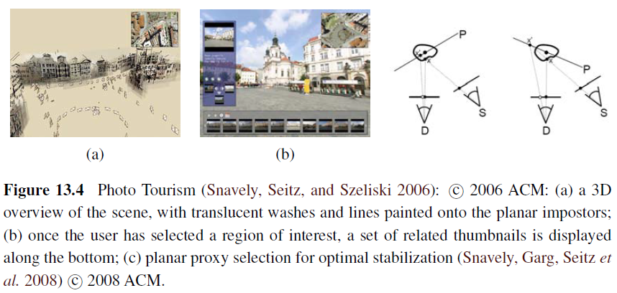
13.1.2 Application: Photo Tourism

Slide 11
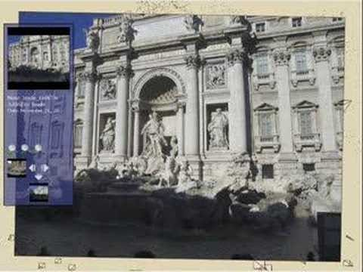
13.1.2 Application: Photo Tourism
https://www.youtube.com/watch?v=mTBPGuPLI5Y

Slide 12
13.2 Layered Depth Images
13.2.1 Imposters, Sprites, and Layers

Slide 13
13.2 Layered Depth Images
When a depth map is warped to a novel view, holes and cracks inevitably appear behind the foreground objects.
One way to alleviate this problem is to keep several depth and color values (depth pixels) at every pixel in a reference image (or, at least for pixels near foreground–background transitions).

Slide 14
13.2 Layered Depth Images
The resulting data structure, which is called a Layered Depth Image (LDI), can be used to render new views using a back-to-front forward warping algorithm (Shade, Gortler, He et al. 1998).

Slide 15
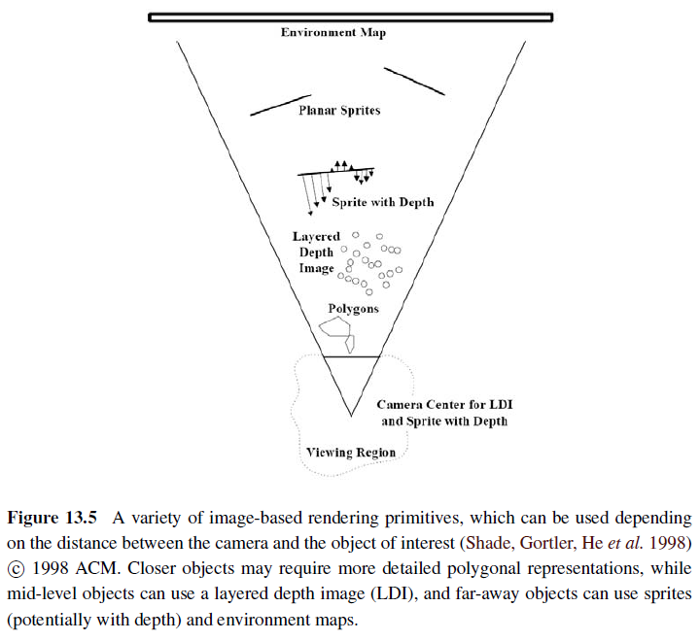
13.2 Layered Depth Images
Rendering Primitives:
Polygons,
Layered Depth Image,
Sprite with Depth,
Planar Sprites,
Environment Map

Slide 16
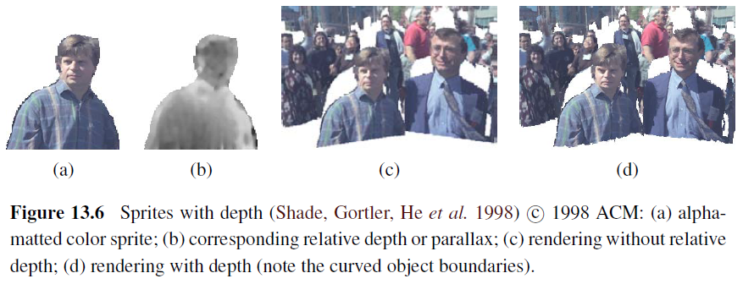
13.2.1 Imposters, Sprites, and Layers
An alternative to keeping lists of color-depth values at each pixel, as is done in the LDI, is to organize objects into different layers or sprites.

Slide 17
13.3 Light Fields and Lumigraphs
13.3.1 Unstructured Lumigraph
13.3.2 Surface Light Fields

Slide 18
13.3 Light Fields and Lumigraphs
Is it possible to capture and render the appearance of a scene from all possible viewpoints and, if so, what is the complexity of the resulting structure?
Let us assume that we are looking at a static scene, i.e., one where the objects and illuminants are fixed, and only the observer is moving around.

Slide 19
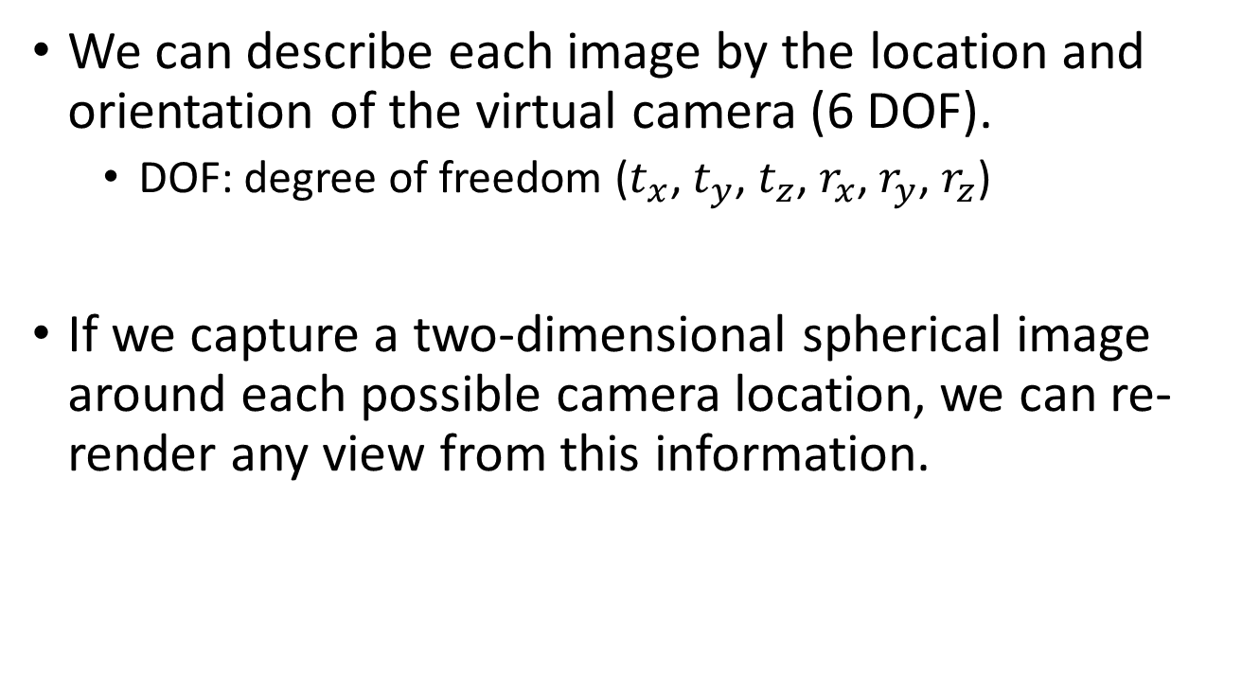
13.3 Light Fields and Lumigraphs
We can describe each image by the location and orientation of the virtual camera (6 DOF).
DOF: degree of freedom ($t_{x}$, $t_{y}$, $t_{z}$, $r_{x}$, $r_{y}$, $r_{z}$)
If we capture a two-dimensional spherical image around each possible camera location, we can re-render any view from this information.

Slide 20
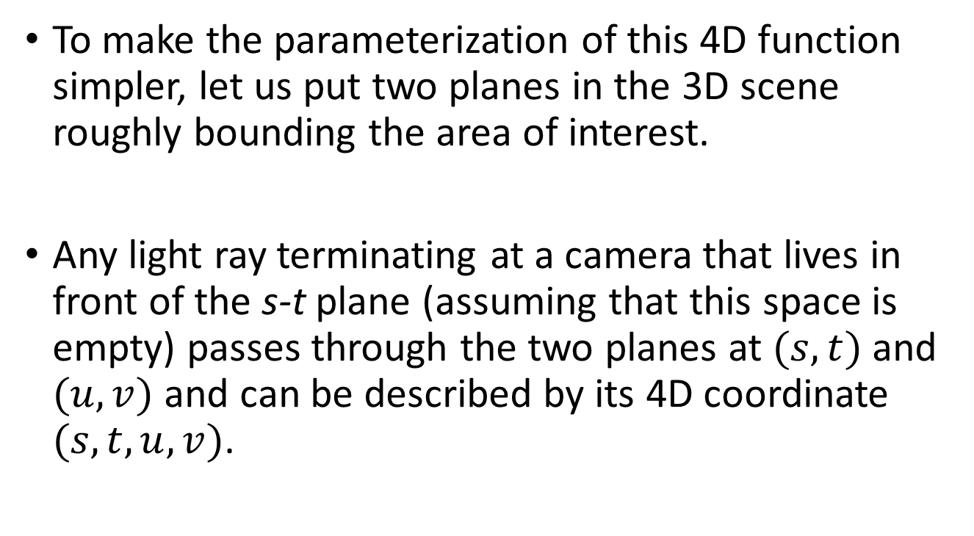
13.3 Light Fields and Lumigraphs
To make the parameterization of this 4D function simpler, let us put two planes in the 3D scene roughly bounding the area of interest.
Any light ray terminating at a camera that lives in front of the s-t plane (assuming that this space is empty) passes through the two planes at $(s,t)$ and $(u,v)$ and can be described by its 4D coordinate $(s,t,u,v)$.

Slide 21
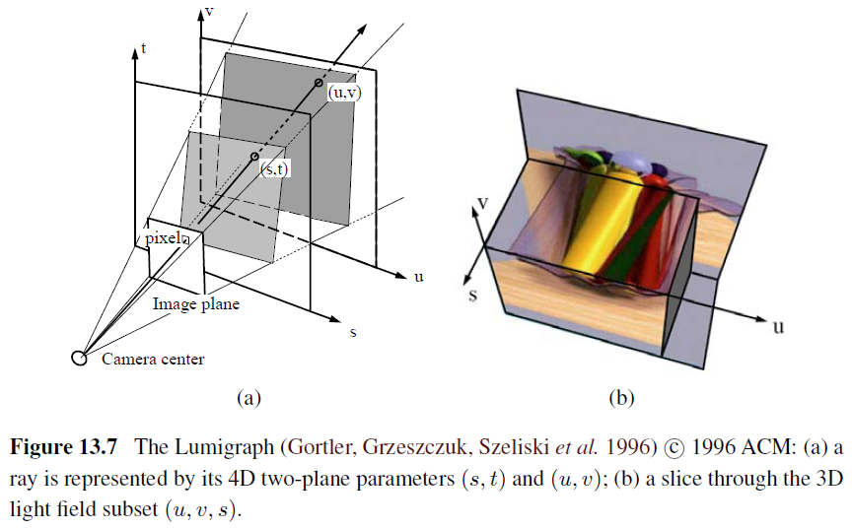
13.3 Light Fields and Lumigraphs

Slide 22
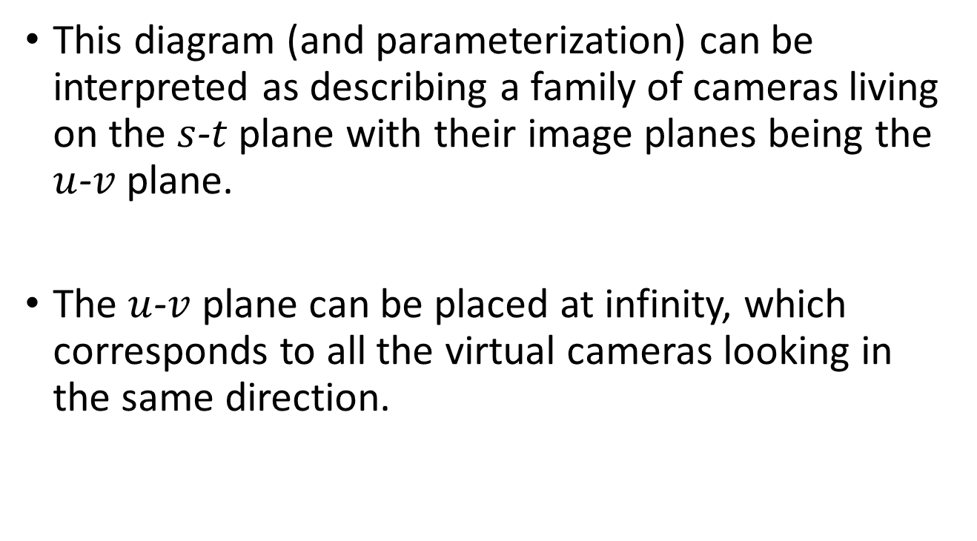
13.3 Light Fields and Lumigraphs
This diagram (and parameterization) can be interpreted as describing a family of cameras living on the $s$-$t$ plane with their image planes being the $u$-$v$ plane.
The $u$-$v$ plane can be placed at infinity, which corresponds to all the virtual cameras looking in the same direction.

Slide 23
13.3 Light Fields and Lumigraphs
While a light field can be used to render a complex 3D scene from novel viewpoints, a much better rendering (with less ghosting) can be obtained if something is known about its 3D geometry.
The Lumigraph system of Gortler, Grzeszczuk, Szeliski et al. (1996) extends the basic light field rendering approach by taking into account the 3D location of surface points corresponding to each 3D ray.

Slide 24
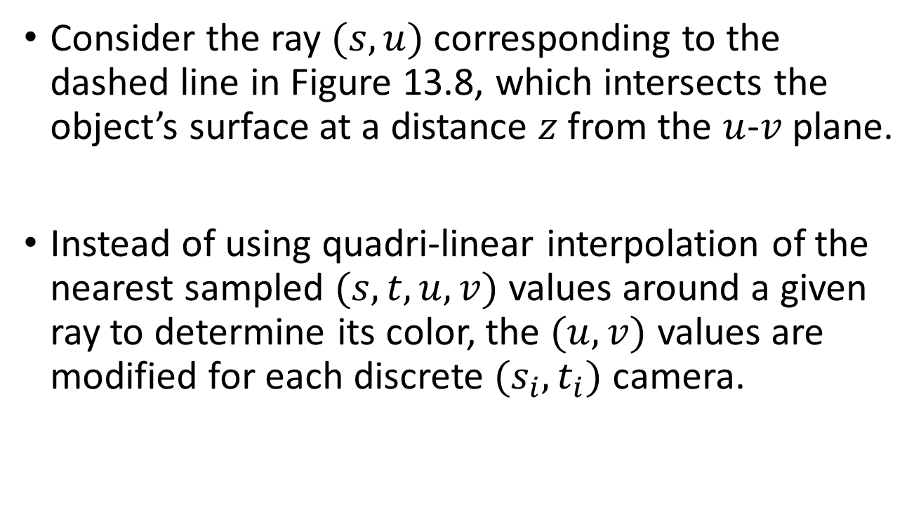
13.3 Light Fields and Lumigraphs
Consider the ray $(s,u)$ corresponding to the dashed line in Figure 13.8, which intersects the object’s surface at a distance $z$ from the $u$-$v$ plane.
Instead of using quadri-linear interpolation of the nearest sampled $(s,t,u,v)$ values around a given ray to determine its color, the $(u,v)$ values are modified for each discrete $(s_{i},t_{i})$ camera.

Slide 25
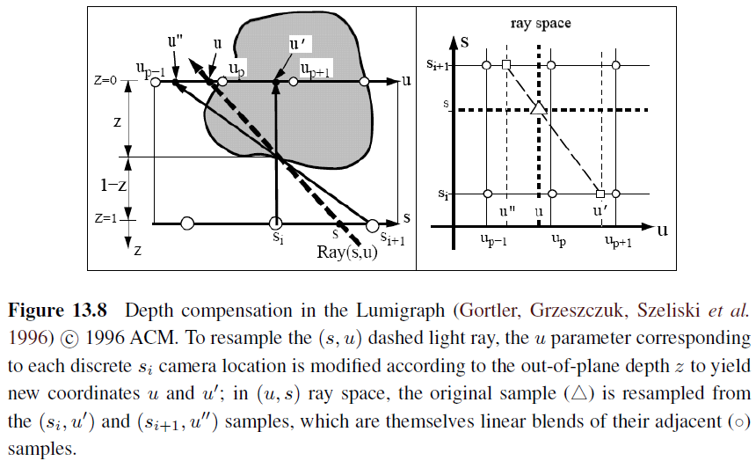
13.3 Light Fields and Lumigraphs

Slide 26
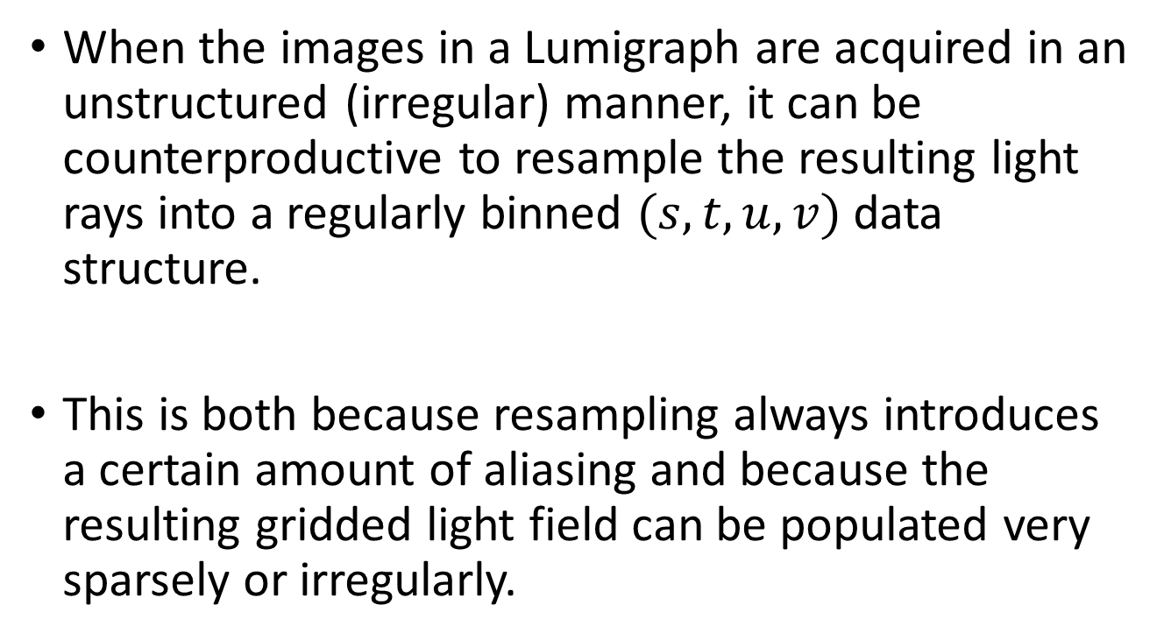
13.3.1 Unstructured Lumigraph
When the images in a Lumigraph are acquired in an unstructured (irregular) manner, it can be counterproductive to resample the resulting light rays into a regularly binned $(s,t,u,v)$ data structure.
This is both because resampling always introduces a certain amount of aliasing and because the resulting gridded light field can be populated very sparsely or irregularly.

Slide 27
13.3.1 Unstructured Lumigraph
The alternative is to render directly from the acquired images, by finding for each light ray in a virtual camera the closest pixels in the original images.

Slide 28
13.3.1 Unstructured Lumigraph
The unstructured Lumigraph rendering (ULR) system of describes how to select such pixels by combining a number of fidelity criteria.
epipole consistency (distance of rays to a source camera’s center)
angular deviation (similar incidence direction on the surface)
resolution (similar sampling density along the surface)
continuity (to nearby pixels)
consistency (along the ray)

Slide 29
13.3.2 Surface Light Fields
If we know the 3D shape of the object or scene whose light field is being modeled, we can effectively compress the field because nearby rays emanating from nearby surface elements have similar color values.
Nearby Lumispheres will be highly correlated and hence amenable to both compression and manipulation.

Slide 30
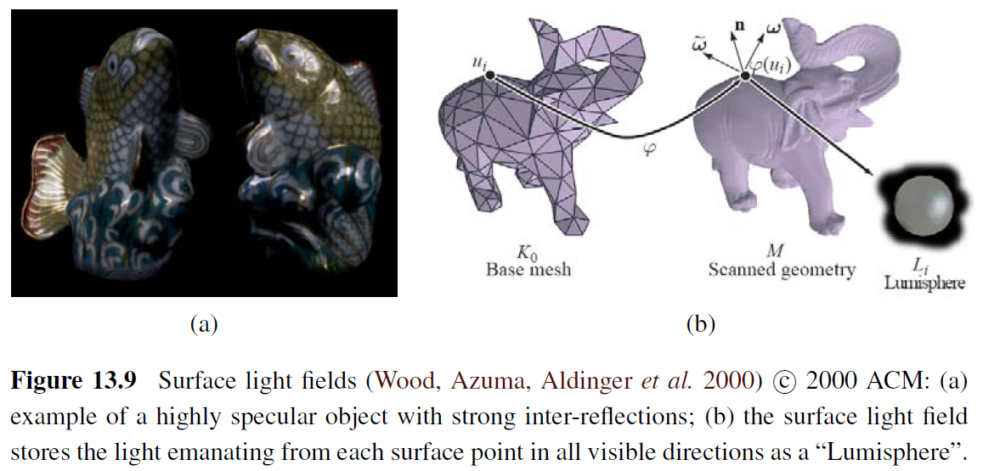
13.3.2 Surface Light Fields

Slide 31
13.3.2 Surface Light Fields
To estimate the diffuse component of each Lumisphere, a median filtering over all visible exiting directions is first performed for each channel.
Once this has been subtracted from the Lumisphere, the remaining values, which should consist mostly of the specular components, are reflected around the local surface normal, which turns each Lumisphere into a copy of the local environment around that point.

Slide 32
13.4 Environment Mattes
13.4.1 Higher-Dimensional Light Fields
13.4.2 The Modeling to Rendering Continuum

Slide 33
13.4 Environment Mattes
What if instead of moving around a virtual camera, we take a complex, refractive object, such as the water goblet shown in Figure 13.10, and place it in front of a new background?
Instead of modeling the 4D space of rays emanating from a scene, we now need to model how each pixel in our view of this object refracts incident light coming from its environment.

Slide 34
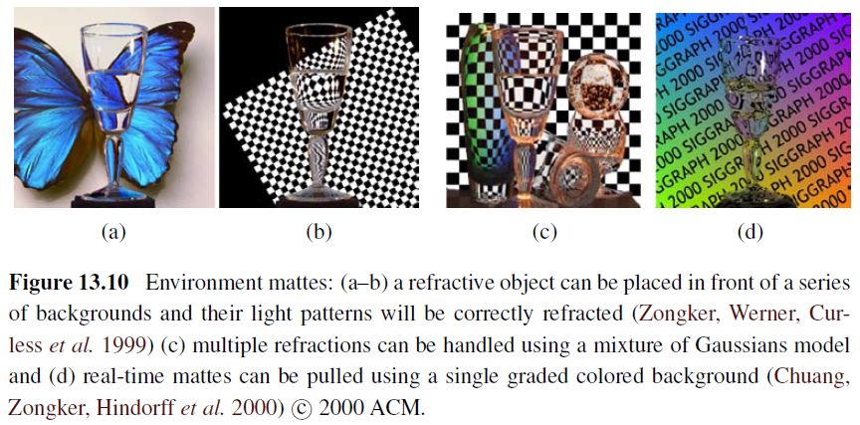
13.4 Environment Mattes

Slide 35

13.4 Environment Mattes
If we assume that other objects and illuminants are sufficiently distant (the same assumption we made for surface light fields, 4D mapping $(x,y)$→$\left(φ,θ\right)$ captures all the information between a refractive object and its environment.

Slide 36
13.4 Environment Mattes
Zongker, Werner, Curless et al. (1999) call such a representation an environment matte, since it generalizes the process of object matting to not only cut and paste an object from one image into another but also take into account the subtle refractive or reflective interplay between the object and its environment.

Slide 37
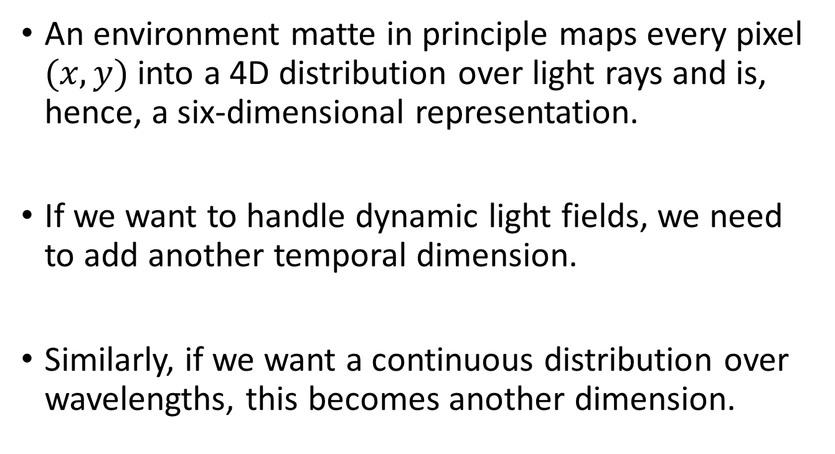
13.4.1 Higher-Dimensional Light Fields
An environment matte in principle maps every pixel $(x,y)$ into a 4D distribution over light rays and is, hence, a six-dimensional representation.
If we want to handle dynamic light fields, we need to add another temporal dimension.
Similarly, if we want a continuous distribution over wavelengths, this becomes another dimension.

Slide 38
13.4.2 The Modeling to Rendering Continuum
The image-based rendering representations and algorithms we have studied in this chapter span a continuum ranging from classic 3D texture-mapped models all the way to pure sampled ray-based representations such as light fields.

Slide 39
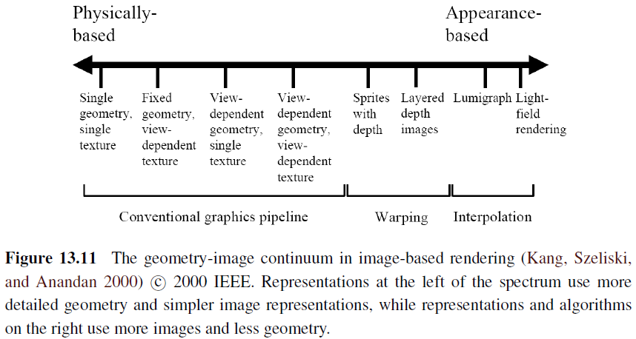
13.4.2 The Modeling to Rendering Continuum

Slide 40
13.4.2 The Modeling to Rendering Continuum
Representations such as view-dependent texture maps and Lumigraphs still use a single global geometric model, but select the colors to map onto these surfaces from nearby images.
The best choice of representation and rendering algorithm depends on both the quantity and quality of the input imagery as well as the intended application.

Slide 41
13.5 Video-Based Rendering
13.5.1 Video-Based Animation
13.5.2 Video Textures
13.5.3 Application: Animating Pictures
13.5.4 3D Video
13.5.5 Application: Video-Based Walkthroughs

Slide 42
13.5 Video-Based Rendering
A fair amount of work has been done in the area of video-based rendering and video-based animation, two terms first introduced by Schödl, Szeliski, Salesin et al. (2000) to denote the process of generating new video sequences from captured video footage.

Slide 43
13.5 Video-Based Rendering
We start with video-based animation (Section 13.5.1), in which video footage is re-arranged or modified, e.g., in the capture and re-rendering of facial expressions.
Next, we turn our attention to 3D video (Section 13.5.4), in which multiple synchronized video cameras are used to film a scene from different directions.

Slide 44
13.5.1 Video-Based Animation
An early example of video-based animation is Video Rewrite, in which frames from original video footage are rearranged in order to match them to novel spoken utterances, e.g., for movie dubbing (Figure 13.12).
This is similar in spirit to the way that concatenative speech synthesis systems work (Taylor 2009).

Slide 45
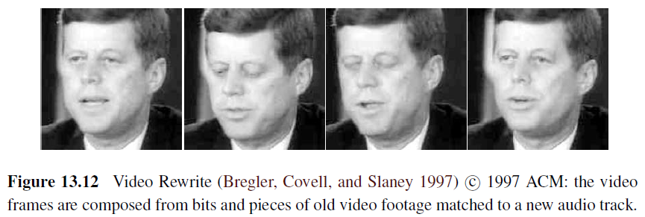
13.5.1 Video-Based Animation

Slide 46
13.5.2 Video Textures
Video texture is a short video clip that can be arbitrarily extended by re-arranging video frames while preserving visual continuity (Schödl, Szeliski, Salesin et al. 2000).
The simplest approach is to match frames by visual similarity and to jump between frames that appear similar.

Slide 47

13.5.3 Application: Animating Pictures
https://www.youtube.com/watch?v=ZVrYyX3bHI8

Slide 48
13.5.4 3D Video
In recent years, the popularity of 3D movies has grown dramatically, with recent releases ranging from Hannah Montana, through U2’s 3D concert movie, to James Cameron’s Avatar.
Currently, such releases are filmed using stereoscopic camera rigs and displayed in theaters (or at home) to viewers wearing polarized glasses.

Slide 49
13.5.4 3D Video
The stereo matching techniques developed in the computer vision community along with image-based rendering (view interpolation) techniques from graphics are both essential components in such scenarios, which are sometimes called free-viewpoint video (Carranza, Theobalt, Magnor et al. 2003) or virtual viewpoint video (Zitnick, Kang, Uyttendaele et al. 2004).

Slide 50
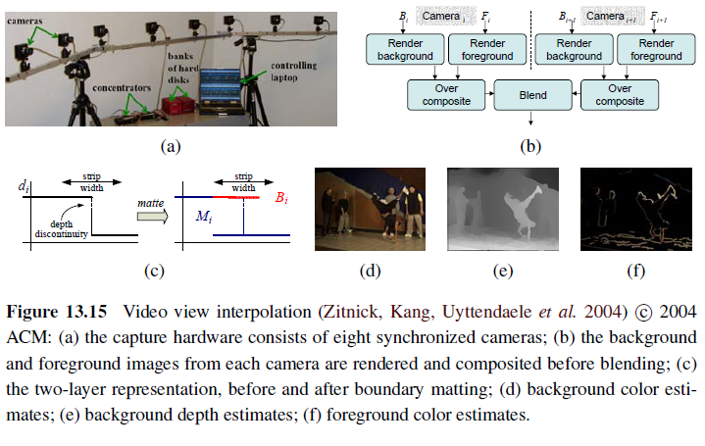
13.5.4 3D Video

Slide 51

13.5.5 Application: Video-Based Walkthroughs
https://www.youtube.com/watch?v=8EfCf1Xt5yA

